Slide 1

PIZZA SALES REPORT
2015 Overview
Prepared By
Hardeep Dhiman

Slide 2
Executive Summary
Our pizza business achieved significant milestones, with total revenue reaching $817.86K from 49,574 pizzas sold across 21,350 orders. This report provides a detailed analysis of sales performance by category, size, and time period, as well as insights into our best and worst-performing products.

Slide 3

Sales performance Metrics
Total revenue: $817.86K
Total Pizzas Sold: 49,574
Total Orders: 21,350
Average Order Value: $38.31
Average Pizzas per Order: 2.32

Slide 4
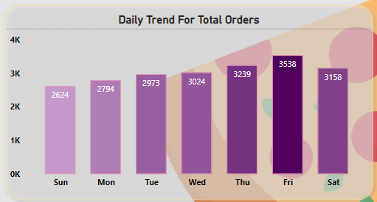
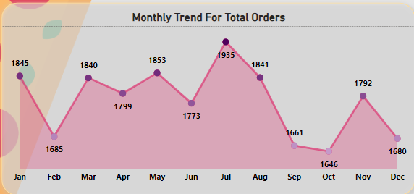
Sales trend Analysis
Busiest Days: Orders peak on weekends, particularly Friday and Saturday evenings.
Monthly Trends: Highest orders were recorded in July and January. July has the most orders throughout the year.
Daily Trends: The highest number of orders occurs on Thursdays and Fridays, with Fridays reaching 3,538 orders.

Slide 5
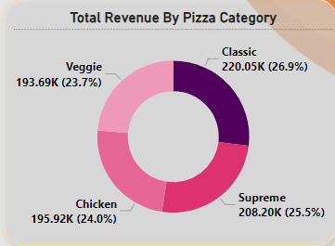
Performance by Pizza Category
Revenue:
Classic Pizza leads with a total revenue of $220.05K (26.9% of total sales).
Other significant categories include Supreme ($208.2K), Chicken ($195.92K), and Veggie ($193.69K).
Pizza Sold by Category:
Classic: 14,888
Supreme: 11,987
Veggie: 11,649
Chicken: 11,050

Slide 6
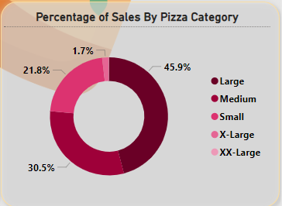
Performance by PizzaSize
Large-sized pizzas are the most popular, contributing to 45.9% of total sales.
Medium pizzas follow at 30.5%, with smaller sizes contributing minimally.

Slide 7
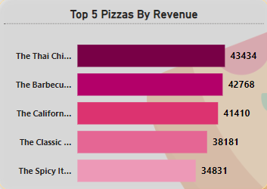
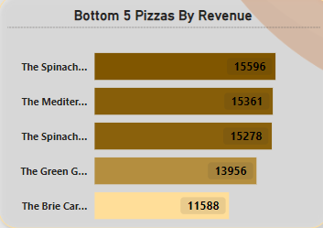
Best and Worst Sellers
Best Sellers:
Revenue Leader: Thai Chicken Pizza
Most Ordered Pizza: Classic Deluxe Pizza
Top 5 by Revenue: Thai Chicken, BBQ Chicken, California Chicken, Classic Deluxe, Spicy Italian.
Worst Sellers:
Brie Carre Pizza performs the worst across revenue, quantity, and orders.
Bottom 5 by Revenue: Brie Carre, Green Garden, Spinach Artichoke, Mediterranean, Spinach Deluxe.

Slide 8
KEY INSIGHTS AND RECOMMENDATIONS
Thai Chicken Pizza emerged as the top revenue contributor, indicating strong customer preference for unique, flavorful options. We should consider introducing more pizzas with exotic flavors.
Classic Deluxe Pizza dominated in both quantity and orders, reaffirming its status as a customer favorite. It might be beneficial to offer special promotions or meal deals featuring this pizza to drive even more sales.
Brie Carie Pizza was the worst performer across all metrics. A review of its recipe, pricing, or marketing strategy might be necessary to either improve its appeal or consider its removal from the menu.
Large Pizzas were the most popular size, contributing nearly half of the total sales. We should explore expanding the large pizza offerings or running promotions focused on this size.
Weekend Promotions: Given the peak in orders on Fridays and Saturdays, targeted promotions during these days could further boost sales.

Slide 9
CONCLUSION
The data from 2015 provides valuable insights into our pizza business's strengths and opportunities. By focusing on our best-selling items and addressing the underperformers, we can continue to enhance our offerings and meet customer demands effectively. Strategic promotions and menu adjustments based on these findings will be crucial in driving future growth.

